Slide 1
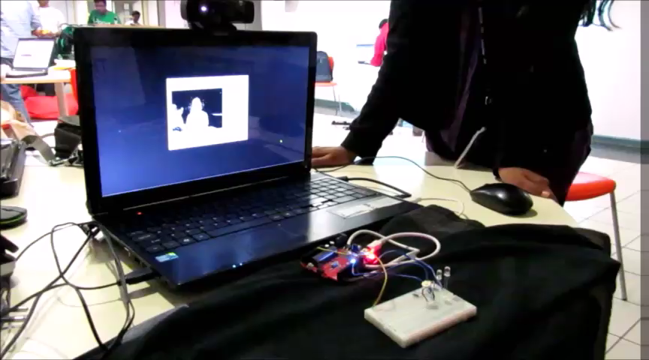
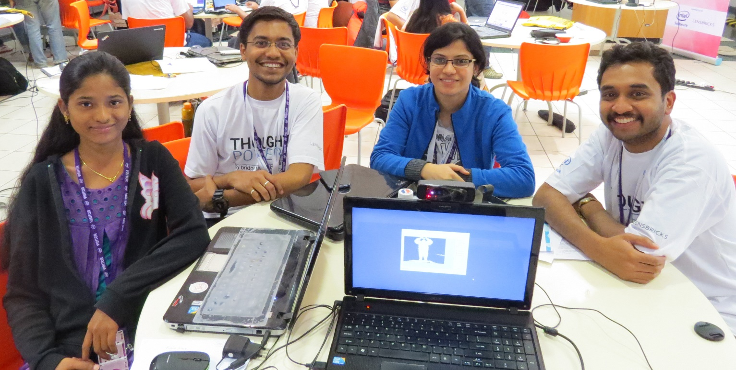
GESTURE BASED HOME LIGHT AUTOMATION
Amaldev V, Krishna Rastogi, Ritika Tanwani, Uha G

Slide 2
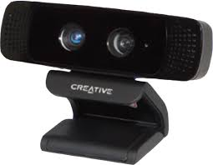
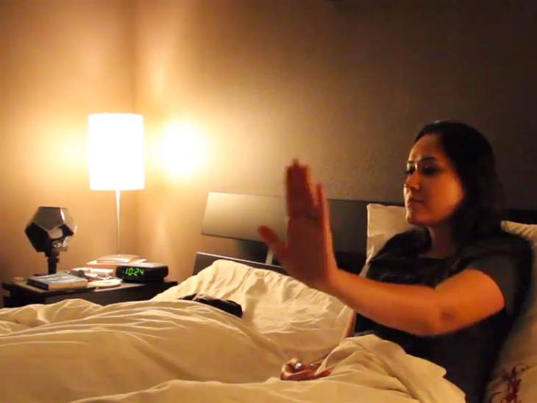




SUMMARY
FUTURE OPPORTUNITIES
Light
Motion
Sound
Notes:
The idea holds a great opportunity wherein people could incorporate such systems in their houses with additional features implemented. Additional features could be motion and sound detection along with light control through gestures. This gesture automation feature can be extended to the other household appliances also.
Our product is a light controlling solution that integrates communication with light control switches through gestures. The major advantage of this over conventional manual switching is the ability to control individual lights using hand gestures. We developed the entire product using the Intel’s Perceptual Computing platform.

